Slide 1


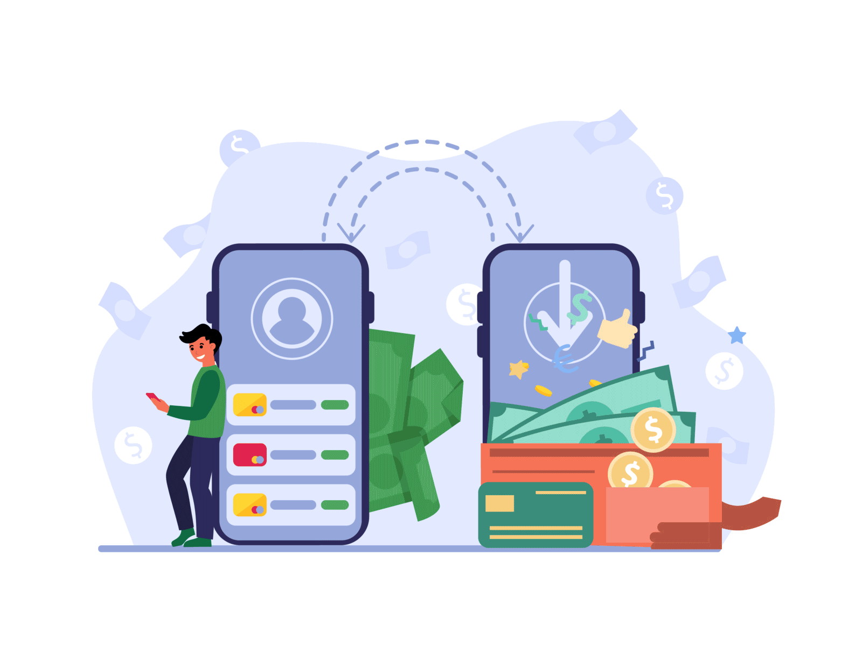


GOSAKU
(Application programming interface e-wallet)

Slide 2






Members of the group
Reyga Fitra Ramadhan M. Fikri Alfarizi
M. Yoga Pratama Novia Sya’baniyah

Slide 3
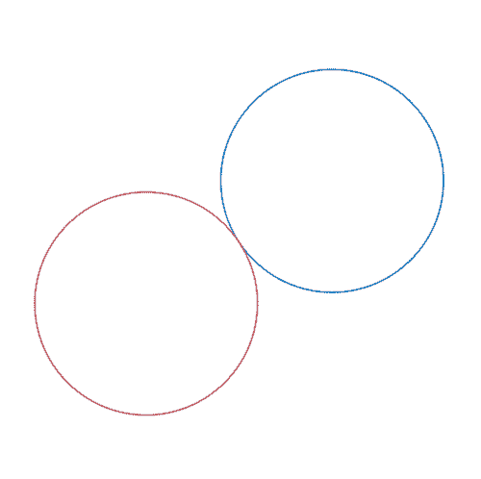

Business PROCESS in applications
Gosaku App Description
Definition of Gosaku
Existing Features on Gosaku
Reward Points Feature
History Transaction Feature

Slide 4


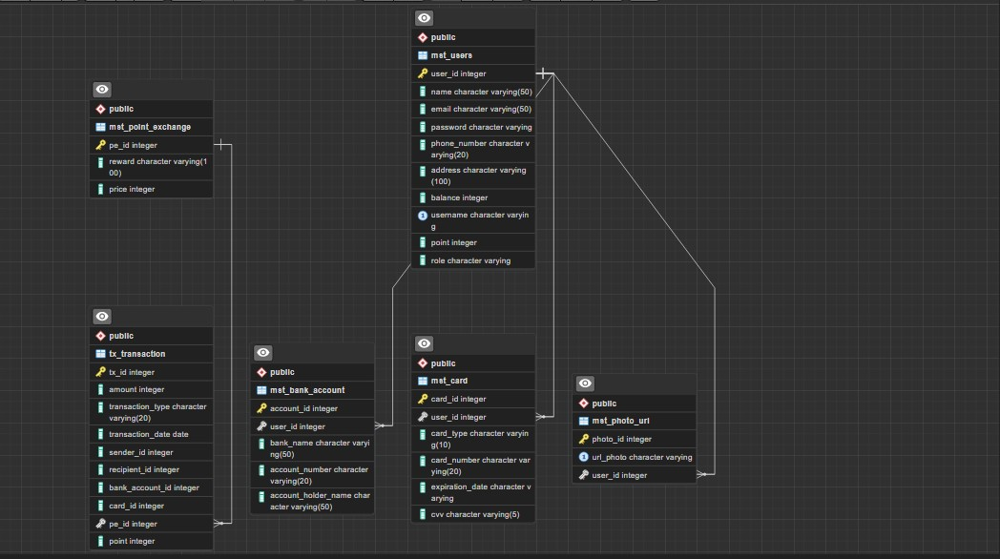
ERD

Slide 5
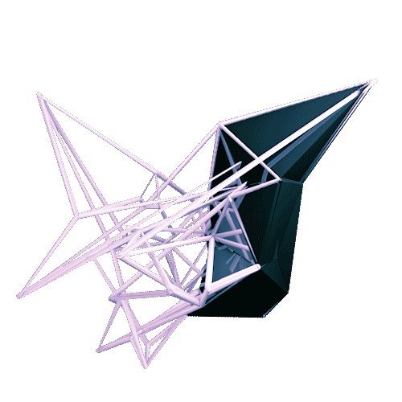
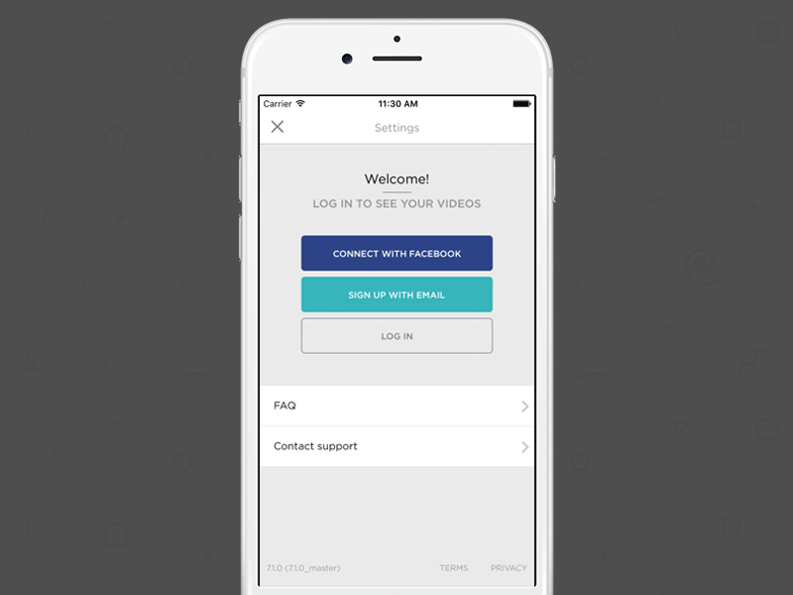
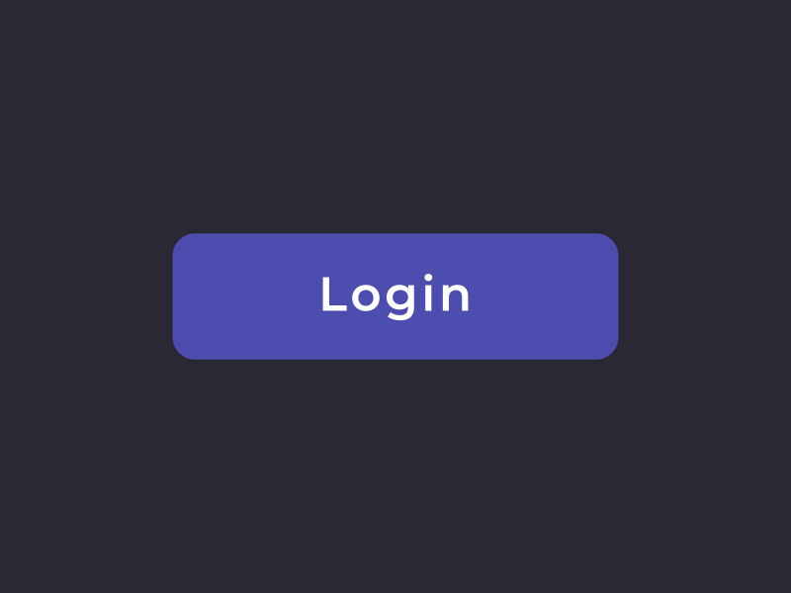
Delivered features
User Login Registration & Authentication
Registration
Login

Slide 6
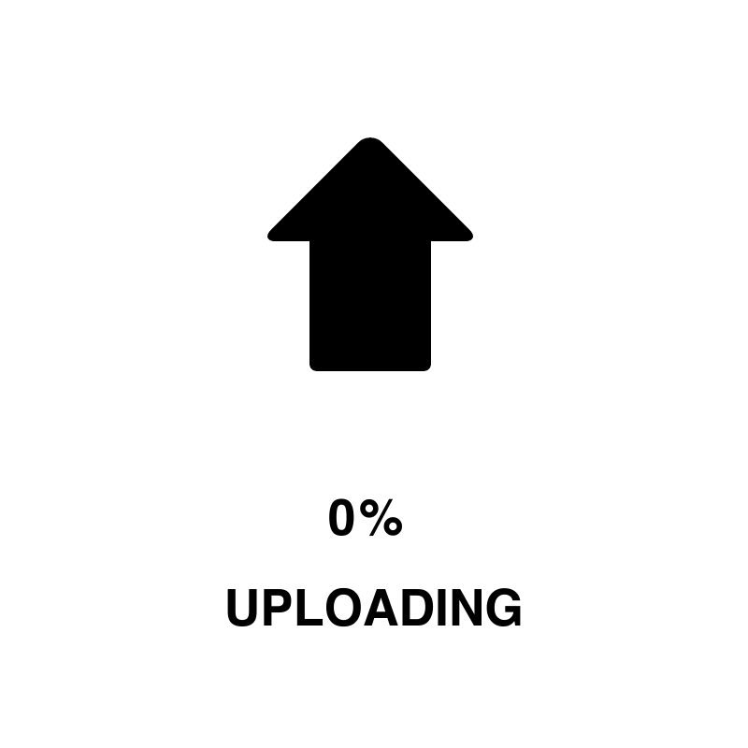

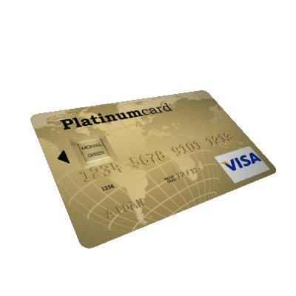

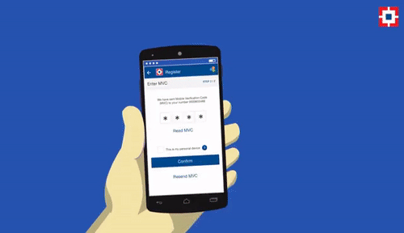
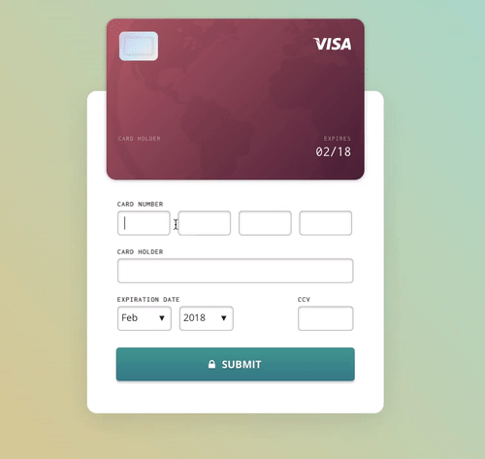
Delivered features
Account Management
Upload/download
Edit profile
Edit bank account
Edit card account
Linking bank account
Linking credit card

Slide 7


Delivered features
Transaction
Make a deposit
Transfer
Redeem points
Withdrawal
Top Up

Slide 8


Delivered features
Security
Users cannot access other user data

Slide 9

Delivered features
Logging
Users
Activities
Log File

Slide 10


The advantages of the system compared to other systems
Reward Point Feature

Slide 11
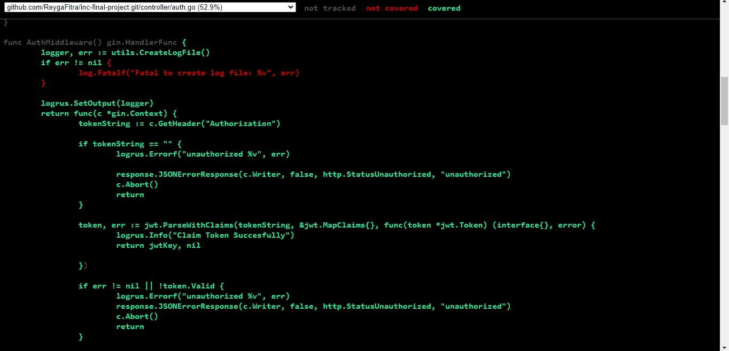
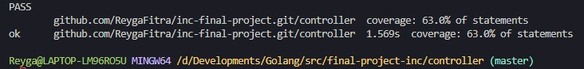
COVERAGE OF UNIT TESTING
controller

Slide 12
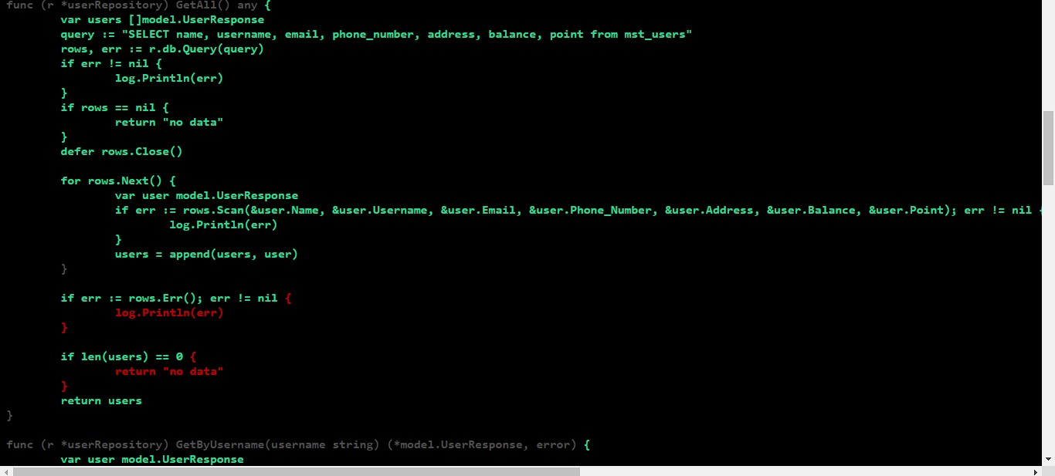
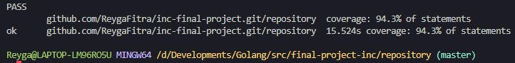
COVERAGE OF UNIT TESTING
repository

Slide 13
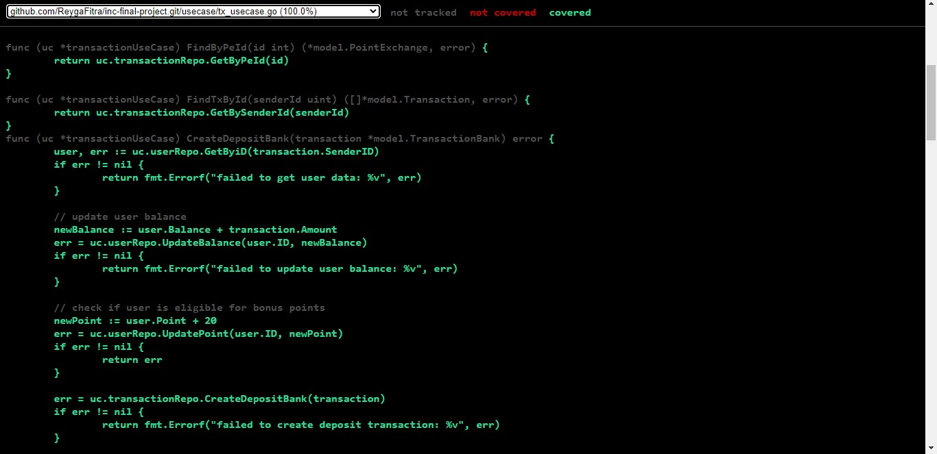
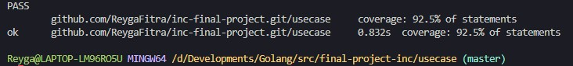
COVERAGE OF UNIT TESTING
usecase

